Slide 1
Documentation Generation
Initial Design
CSCI 2340

Slide 2
Problem Statement
Documentation is difficult to write and keep up to date.
The goal of this project is to provide developers a more reasonable initial set of documentation using LLMs and other tools.

Slide 3
Specifications
The initial implementation of our project will be a web app that, when provided with a github link, generates a confluence page describing what the app does based on classes/methods within.
The confluence pages shall follow the same file structure as the source code and shall have a one to one mapping. Each page shall describe the source code at the functional level, ensuring that the source code is covered to an acceptable level.
The application shall utilize a Retrieval-Augmented Generation (RAG) backend to construct the documentation
The application shall integrate Github Actions such that a push to main in a hypothetical target repository would trigger a regeneration of the confluence page. This will ensure that the documentation remains up to date

Slide 4
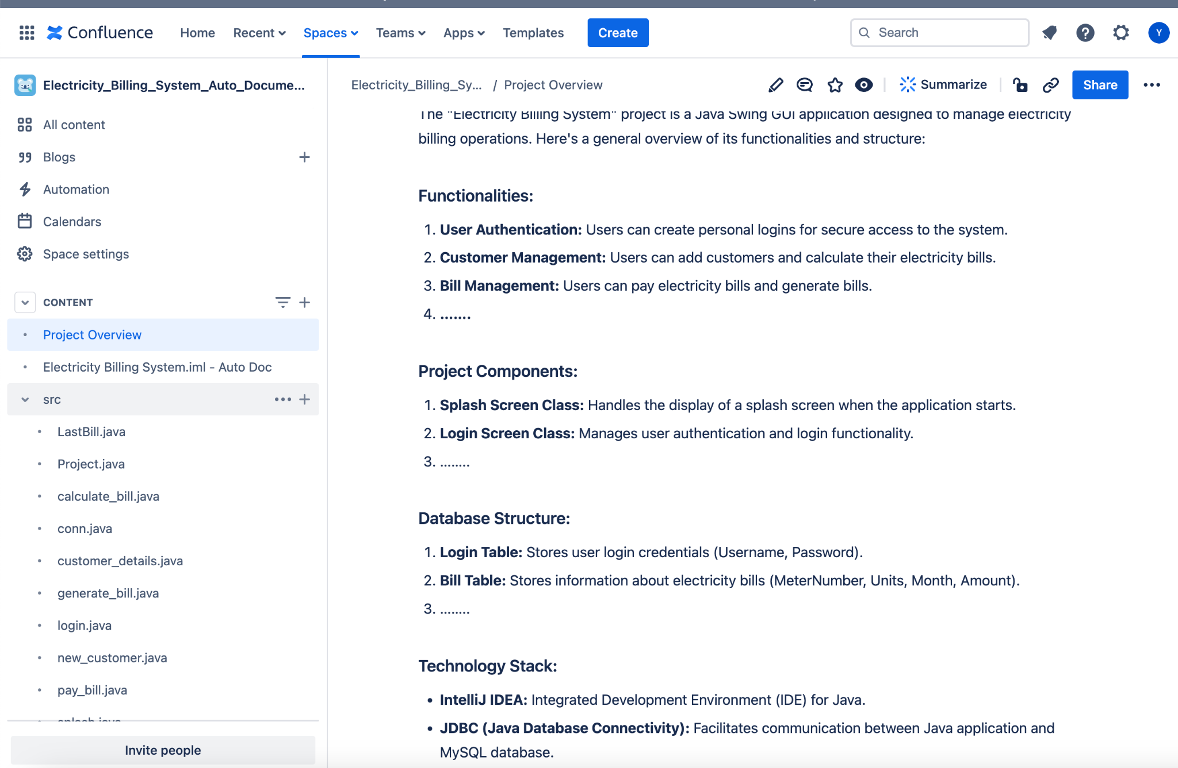
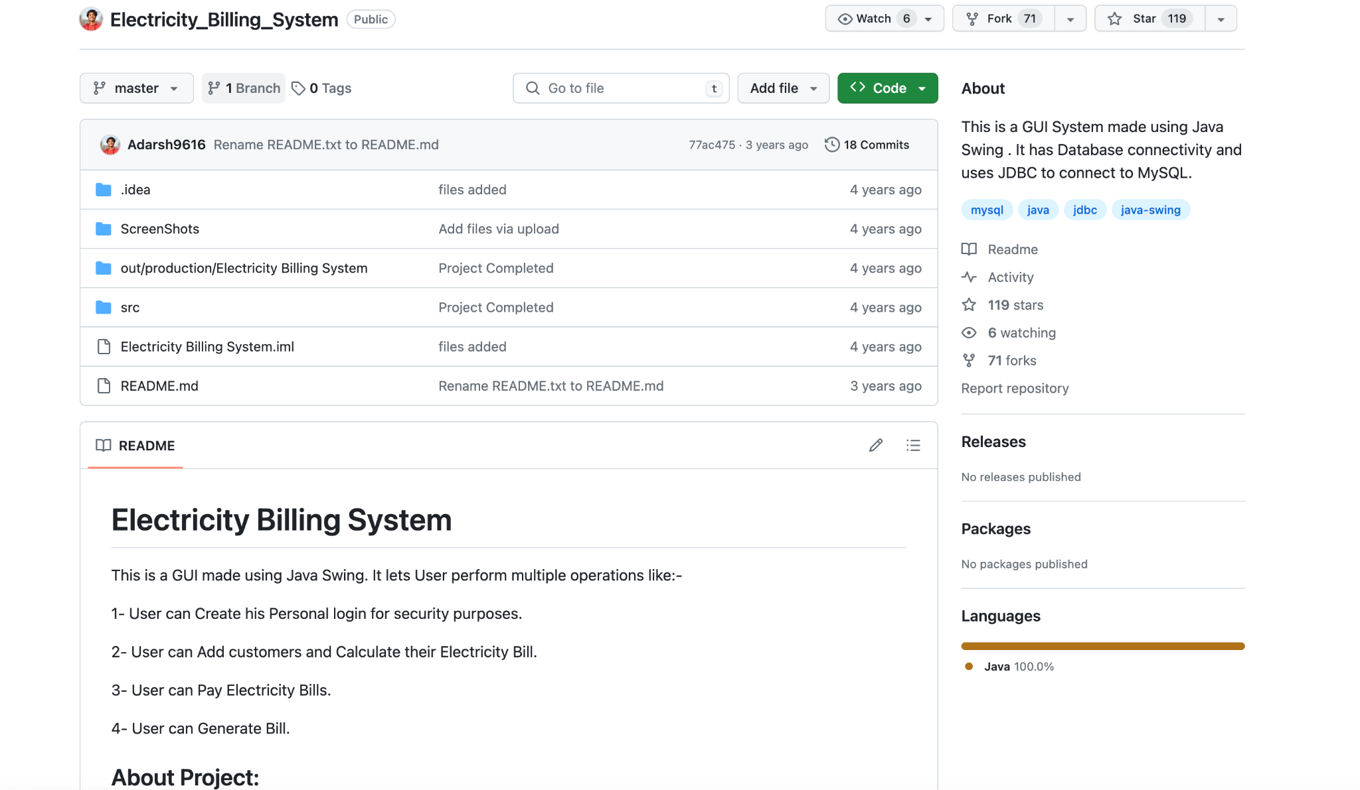
https://github.com/Adarsh9616/Electricity_Billing_System/tree/master

Slide 5
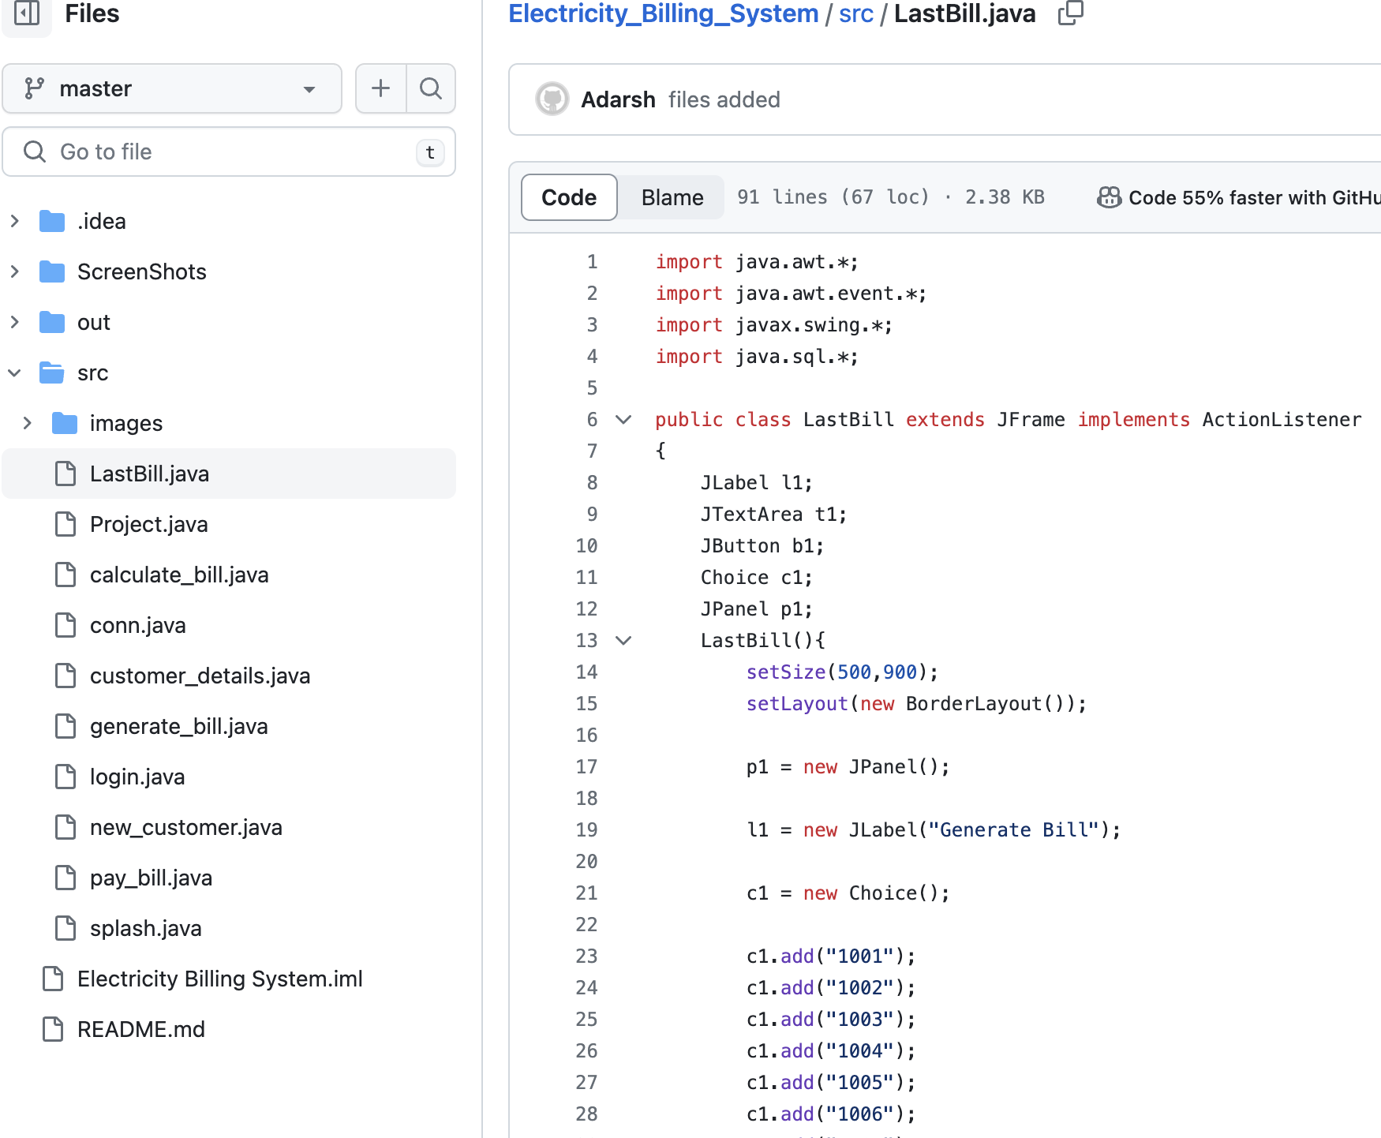
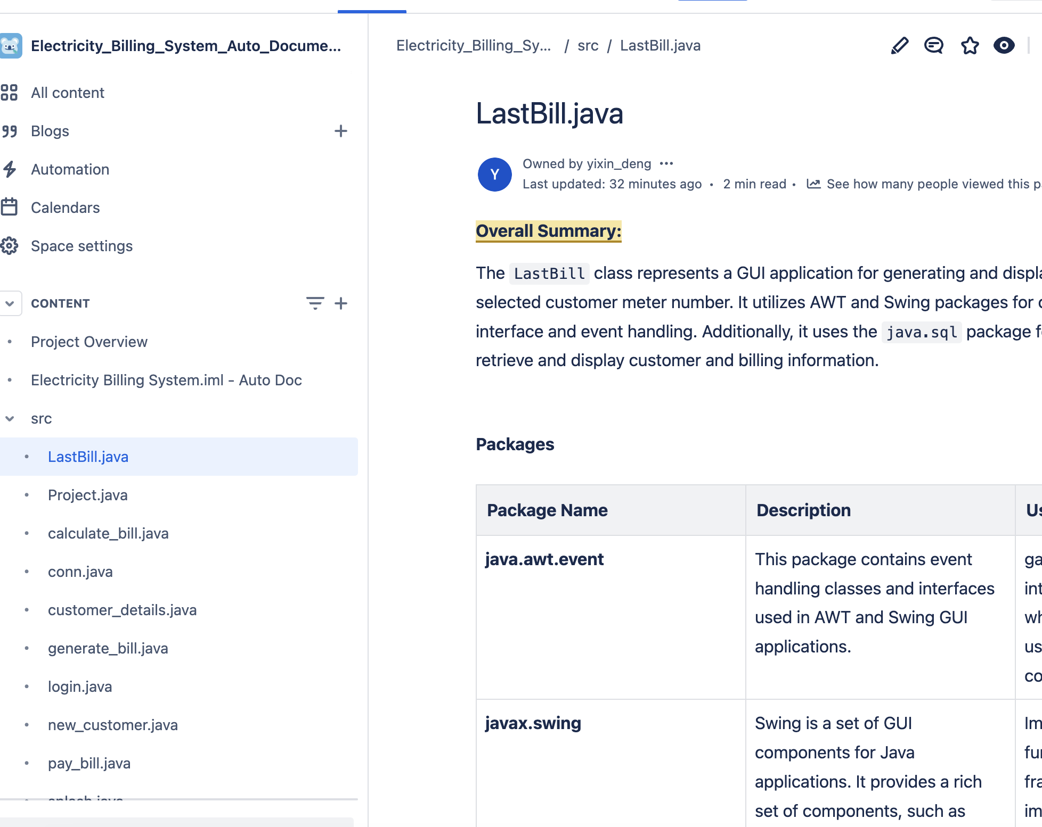

Slide 6
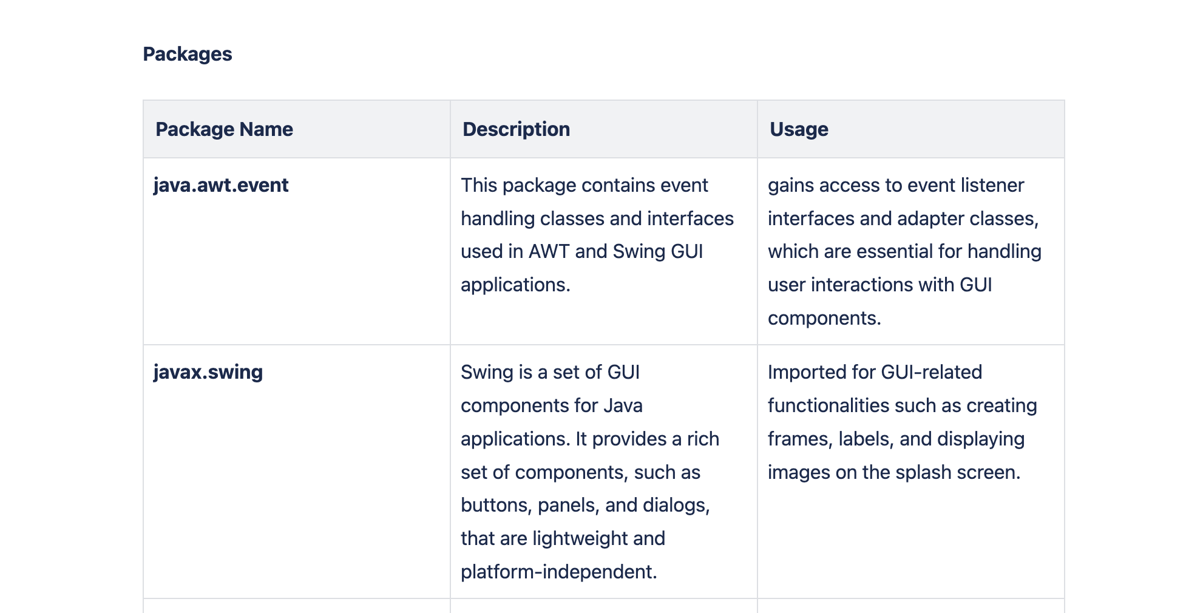
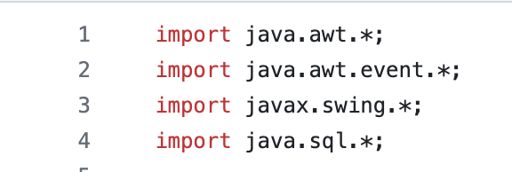
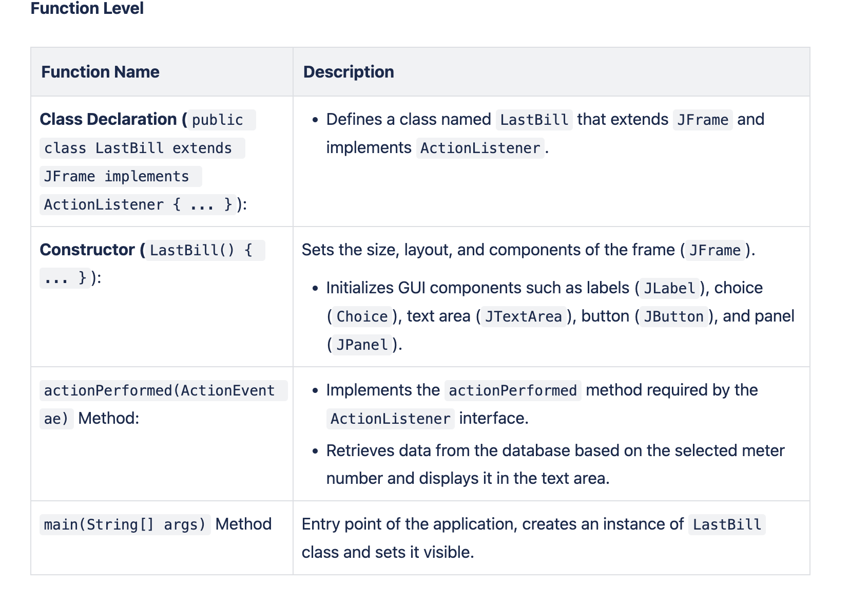
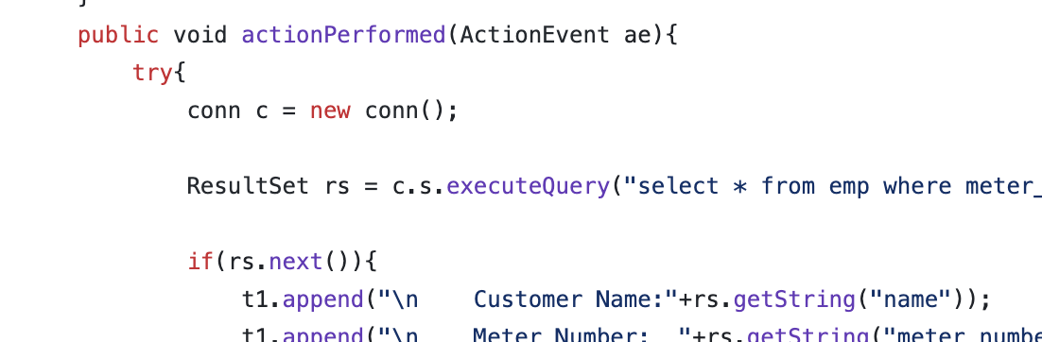

Slide 7
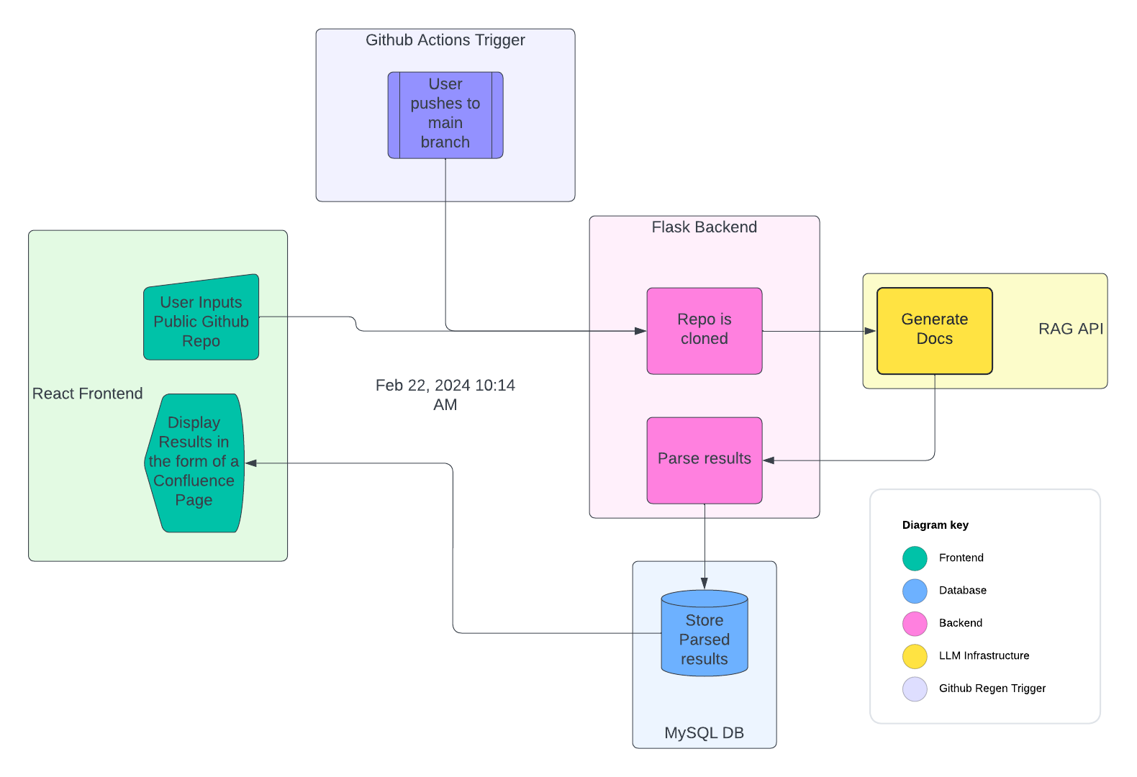
Current Architecture

Slide 8
Frontend
React was chosen for its simplicity
The UI will remain basic
URL Input
Button to generate page
The generated page will be displayed to the user

Slide 9
Backend
Flask was chosen because interfacing with the RAG is simplest with python
Lightweight when compared to Django
Plentiful APIs for pulling and committing to Repositories

Slide 10
Database
For repeated access, a MySQL database will be utilized
Ensures a structured approach to storing / cleaning data
Clean integrations with FE and BE

Slide 11
LLM Integration
Utilizing langchain and llama_index
Utilizing OpenAI’s models:
gpt-3.5
gpt-4

Slide 12
Regenerating Docs
Github Actions features tools to invoke a CI/CD pipeline
This pipeline can be integrated with our application
On a push to main, we can have our codebase build a new series of documentation

Slide 13
Questions?

